Slide 1
IT Security and Penetration Testing
Chapter 2
Reconnaissance

Slide 2
Objectives
Identify various techniques for performing reconnaissance
Distinguish and discuss the methods used in social engineering
Discuss the importance of dumpster diving in reconnaissance
Identify a variety of phases of Internet footprinting
Computer Security and Penetration Testing

Slide 3
Reconnaissance
Reconnaissance
  Act of locating targets and developing the methods necessary to attack those targets successfully
  May be extremely flexible and creative
Reconnaissance is not by definition illegal
  Many reconnaissance techniques are completely legal
Computer Security and Penetration Testing

Slide 4
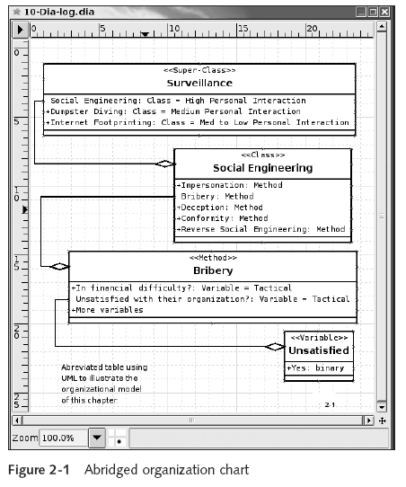
Computer Security and Penetration Testing

Slide 5
Some Legal Reconnaissance
Legal activities
  Looking up all of the information about a company available on the Internet
  Calling with a problem requiring customer service assistance
  Interviewing a member of the staff for a school project
  Physical entry of a facility, including attending a tour of the facility
  Making friends with somebody who works there or used to work there
Computer Security and Penetration Testing

Slide 6
Some Questionable Reconnaissance
Questionable activities
  Performing a passive port scan
  Reading the names on the mail sitting on a mail cart
  Scanning the document lying loose on a desk
  Picking up trash in the parking lot
  Picking up a copy of the employee newsletter
  Asking for a phone list, business card or product specs
  Looking through a garbage can
  War driving
Computer Security and Penetration Testing

Slide 7
Some Illegal Reconnaissance
Illegal activities
  Developing a “front” company for the purpose of robbing or defrauding
  Stealing garbage
  Entering a home or office to look for information
  Dropping a keylogger
  Leaving a sniffer
Computer Security and Penetration Testing

Slide 8
Social Engineering
Social engineering works, for the most part, because people are trusting and helpful
The weakest link in any security scheme is the user
The success or failure of social engineering
  Depends on the ability of hackers to manipulate human psychology, contacts, and physical workstations
Computer Security and Penetration Testing

Slide 9
Social Engineering Techniques
Impersonation
  Could be at an instance level (impersonating someone)
  Could be on a role or function level (dressing like a service person)
Bribery
  Hacker can pit a person’s greed and ignorance against his loyalty to the organization
  Blackmail is a common tactic to keep a target employee fruitful
Computer Security and Penetration Testing

Slide 10
Social Engineering Techniques (continued)
Deception
  Achieve access to information by joining the company
    As an employee or a consultant
Conformity
  Hacker convinces the victim that they have a lot in common and that they share the same values
  Hacker becomes the victim’s good friend
Reverse social engineering
  Hacker projects herself as an authority vested with the power to solve peoples’ problems
Computer Security and Penetration Testing

Slide 11
Physical Intrusion
Foremost traditional technique of social engineering
Requires
  Learning the schedules of the organization
  Knowing the floor plan of the building or buildings
  “Baselining” the security procedures
Hacker can develop fake identification cards
Last step is to acquire useful or valuable information
Computer Security and Penetration Testing

Slide 12
Physical Intrusion (continued)
Avoiding suspicion
  Never collect all the required information from a single user or source
  Never hold a position after the value of the position has ended
The more valuable the information is, the more likely hackers are working with a team
When physical intrusion is not a possibility, hackers use communication media
Computer Security and Penetration Testing

Slide 13
Communication Media
Postal Mail
  Powerful tool for social engineers
  Typical attack
    Victim receives a letter announcing that he or she has won a prize
    Mailer asks for tax information, phone numbers, e-mail addresses, and other information
    Greed leads the victim to happily surrender all sorts of information
E-mail
  Used in a variety of scams and false offerings
Computer Security and Penetration Testing

Slide 14
Communication Media (continued)
E-mail
  Attacks
    Hacker sends an e-mail purported to be from a legitimate IT e-mail account
      Asks for user’s password to help solve a problem
    Hacker sends e-mail message invitations to join online competitions for receiving prizes
      Joining requires sending sensitive information
    Phishing
      User is tricked into giving private information about his or her account with a known large organization
Computer Security and Penetration Testing

Slide 15
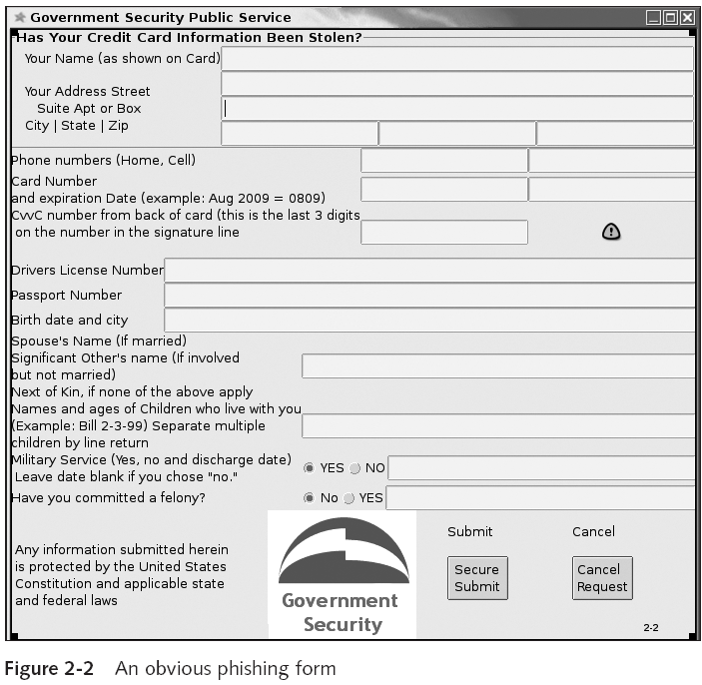
Computer Security and Penetration Testing

Slide 16
Communication Media (continued)
Instant Messaging
  Social engineer attempts to befriend the victim
    To gather information or send the victim to a Web link she might be likely to visit
Telephone Communication
  Social engineers may manipulate background sounds and their own voice to produce a required effect
  Help desk personnel are vulnerable targets
  Social engineers often impersonate technicians
Computer Security and Penetration Testing

Slide 17
Countering Social Engineering
Steps to counter social engineering attempts:
  Do not provide any information to unknown people
  Do not disclose any confidential information to anyone over the telephone
  Do not type passwords or other confidential information in front of unknown people
  Do not submit information to any insecure Web site
  Do not use same username/password for all accounts
  Verify credentials of persons asking for passwords
Computer Security and Penetration Testing

Slide 18
Countering Social Engineering (continued)
Steps to counter social engineering attempts:
  Keep confidential documents locked
  Lock or shut down computers when away from the workstation
  Instruct help desk employees to provide information only after they have gained proper authentication
Computer Security and Penetration Testing

Slide 19
Dumpster Diving
Dumpster diving
  Often the mother lode of sensitive information as well as actual hardware and software
Hackers look specifically for sales receipts and paperwork
  That contain personal data or credit card information
Shredded documents can lead to data leaks
Drafts of letters are routinely left whole in the trash
Company directory sheets, catalog lists, unused or misprinted labels, and policy manuals
Computer Security and Penetration Testing

Slide 20
Importance of Proper Discarding of Refuse
Security policy must carefully address what is sensitive information
  And decide how to treat refuse
Best solution to theft of trash paper
  Crosscut-shred it and keep it in locked trash receptacles
Hackers search for outdated hardware
  There are tools that can restore data from damaged data-storage devices
Computer Security and Penetration Testing

Slide 21
Prevention of Dumpster Diving
Guidelines that help preventing dumpster diving
  Develop a written recycling and trash-handling policy
  Use the policy to develop a consistent, systematic method for handling trash
  The trash-handling policy should state that all papers be shredded
  Erase all data from tapes, floppies, and hard disks
  Simply breaking CD-ROMs is not sufficient, place them in a microwave and heat them
Computer Security and Penetration Testing

Slide 22
Internet Footprinting
A technical method of reconnaissance
Hackers like this method because it is clean, legal, and safe
Four methods used in Internet footprinting
  Web searching
  Network enumeration
  Domain Name System (DNS)–based reconnaissance
  Network-based reconnaissance
Computer Security and Penetration Testing

Slide 23
Web Searching
Search Engines
  Can be used to collect information about any subject or organization
  Companies’ basic information are available through search engines
  Any company or organization is vulnerable to innocent searches
HTML Source Code
  You can view the source code of any Web page
  Area of interest in an HTML source code is its comment entries and the hints of the organization of the site
Computer Security and Penetration Testing

Slide 24
Web Searching (continued)
HTML Source Code (continued)
  Knowing the format of usernames or passwords can be useful
  You should have a default or an index page in every subdirectory
Newsgroups
  Text-based online groups in which users discuss subjects that interest them
  Part of an online bulletin board system called USENET
  Hackers read postings in newsgroups to discover information and documents relating to targeted systems
Computer Security and Penetration Testing

Slide 25
Web Searching (continued)
Security-Related Web Sites
  Hackers study these Web sites to learn about new developments in information security
    Especially about new exploits
Newsletters
  Provide cutting-edge developments to hackers
  Most of the time are available free of charge
  Automatically e-mailed to individuals
Computer Security and Penetration Testing

Slide 26
Network Enumeration
Process of identifying domain names as well as other resources on the target network
WHOIS Search
  WHOIS
    Internet tool that aids in retrieving domain name–specific information from the NSI Registrar database
    Allows the InterNIC database to be queried
      Displays the information about the searched item
  Hackers use the WHOIS tool first to extract critical data about their target system
    And then to conduct hacking activities
Computer Security and Penetration Testing

Slide 27
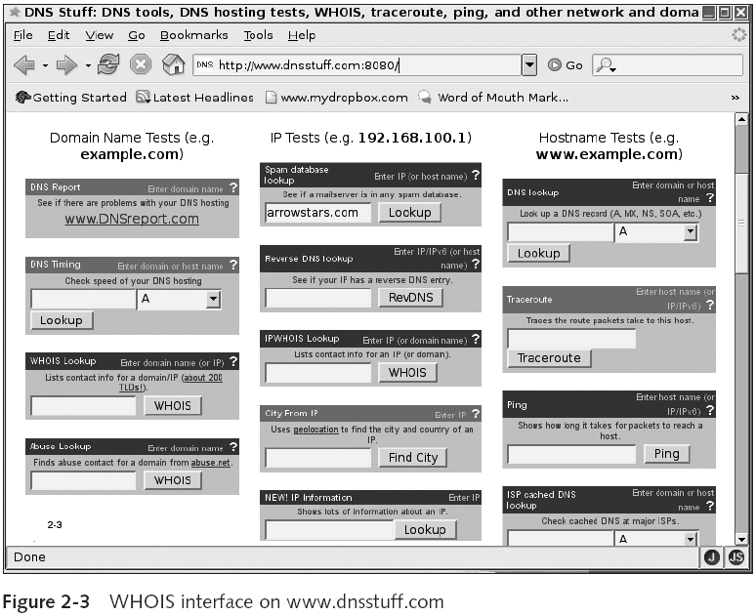
Computer Security and Penetration Testing

Slide 28
Network Enumeration (continued)
whois CLI Command
  WHOIS Web application is also available at the command-line interface (CLI)
    Of POSIX systems like UNIX, Solaris, and Linux
Computer Security and Penetration Testing

Slide 29
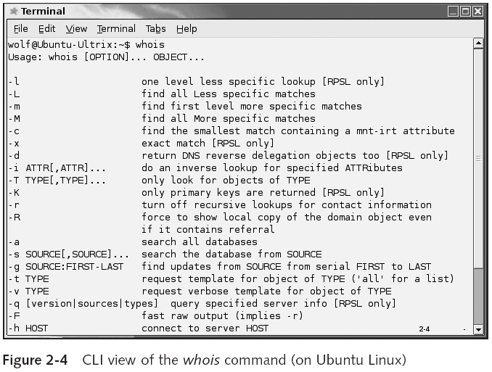
Computer Security and Penetration Testing

Slide 30
Domain Name System (DNS)–Based Reconnaissance
DNS Lookup
  Tools help Internet users discover the DNS names of target computers
  Web sites that provide DNS lookup tools
    www.dnsstuff.com
    www.network-tools.com
    www.networksolutions.com
DNS Zone Transfer
  Every DNS server has a name space, known as a zone
  A zone stores data about domain names
Computer Security and Penetration Testing

Slide 31
Domain Name System (DNS)–Based Reconnaissance (continued)
DNS Zone Transfer (continued)
  Zone transfer is a DNS feature that lets a DNS server update its database
    With the list of domain names in another DNS server
  An incorrectly configured DNS server may allow any Internet user to perform a zone transfer
  Commands to perform a DNS zone transfer
    nslookup
      Allows anyone to query a DNS server for information
    host
      Program that permits you to perform DNS lookup
Computer Security and Penetration Testing

Slide 32
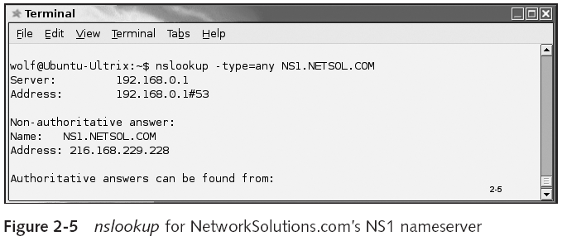
Domain Name System (DNS)–Based Reconnaissance (continued)
Computer Security and Penetration Testing

Slide 33
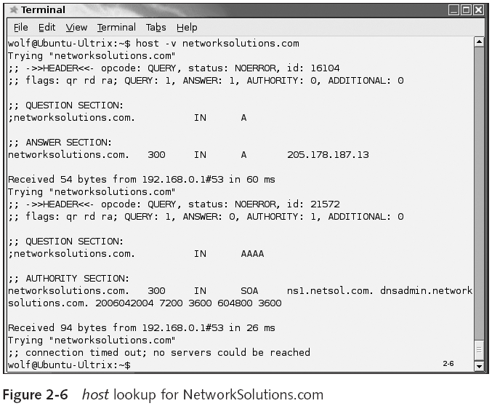
Computer Security and Penetration Testing

Slide 34
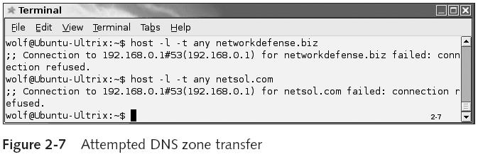
Computer Security and Penetration Testing

Slide 35
Domain Name System (DNS)–Based Reconnaissance (continued)
DNS Zone Transfer (continued)
  Commands to perform a DNS zone transfer
    dig
      Domain information groper (dig)
      Used to collect DNS-related data
Computer Security and Penetration Testing

Slide 36
Network-Based Reconnaissance
ping
  Part of the Internet Control Message Protocol (ICMP)
  Helps to verify whether a host is active
  Command is available for all platforms
  There are two ping utilities available for a Linux or Unix machine: ping and ping6
traceroute
  A request for a Web page that resides on a remote server must pass through several servers on its way
  Command can track all of the intermediate servers
Computer Security and Penetration Testing

Slide 37
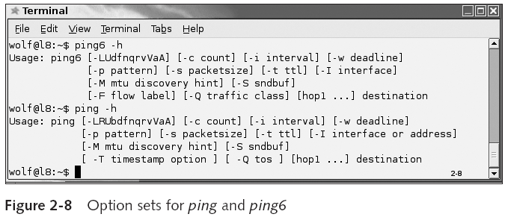
Computer Security and Penetration Testing

Slide 38
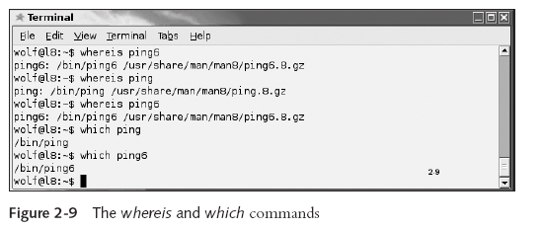
Computer Security and Penetration Testing

Slide 39
Network-Based Reconnaissance (continued)
traceroute
  In UNIX-based operating systems use traceroute command
  In Windows operating systems use tracert command
Computer Security and Penetration Testing

Slide 40
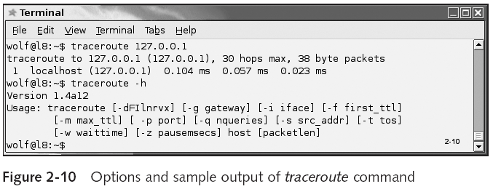
Computer Security and Penetration Testing

Slide 41
Network-Based Reconnaissance (continued)
netstat
  Allows all the transmission Control Protocol (TCP), User Datagram Protocol (UDP), and IP connections on a computer to be viewed
  Also helps to locate
    IP address of computers
    IP addresses of the hosts connected to the computers
    Port of the host to which a computer is connected
Computer Security and Penetration Testing

Slide 42
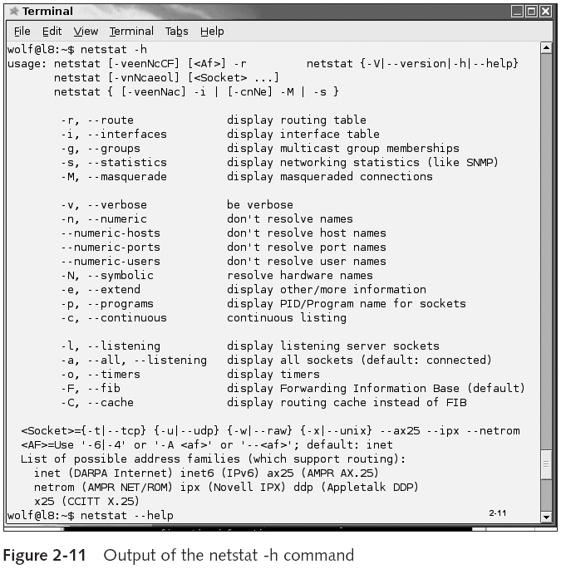
Computer Security and Penetration Testing

Slide 43
Summary
Reconnaissance is the act of locating targets and developing the methods necessary to attack those targets successfully
Social engineering works because people are, for the most part, trusting and helpful
To counter social engineering, organizations must establish known security policies and conduct mandatory security training
Dumpster diving can provide hackers with sensitive information, as well as hardware and software
Computer Security and Penetration Testing

Slide 44
Summary (continued)
Four methods of Internet footprinting: Web searching, network enumeration, Domain Name System (DNS)-based reconnaissance, and network-based reconnaissance
During Web searching, hackers collect information about a target organization by reading Web pages produced by that organization
Network enumeration is the process of identifying domain names and other resources on the target network
Computer Security and Penetration Testing

Slide 45
Summary (continued)
DNS-based reconnaissance uses information available from DNS servers about the IP addresses of target network domain names
Network-based reconnaissance is the process of identifying active computers and services on a target network via tools such as ping, traceroute, and netstat
Computer Security and Penetration Testing

